Slide 1
FIRST PHASE PRESENTATION
PROJECT TITLE:
“InteliCrop - Farmers Help Desk for Major Cropping Pattern Prediction Using Machine Learning Techniques”
Submitted By
Deepak DR(4MO21IS014)
Sinchana G(4MO21IS041)
Aishwarya KL(4MO21IS003)
Kiran U(4MO21IS025)
Under the Guidance of : Dr Jayaram C V
Asst.Prof.Dept Of CSE

Slide 2
AGENDA
Introduction
Literature survey
Overall architecture
Proposed methodology
Proposed plan of action
Expected outcome
Reference.

Slide 3
INTRODUCTION
It is crucial for the farmers to know what all different types of crops can be cultivated in his/her land so as to get good crop quality and yield.
As current system is the manual system which needs more time, experience and proper judgements which may lead to less crop yield and loss to farmers.
There are important relationship between different types of crops so as to get better crop yields. As we do not have the proper system to find the cropping patters, we require a automation for cropping patterns prediction to help farmers to grow better crops types for better yield and profits.

Slide 4
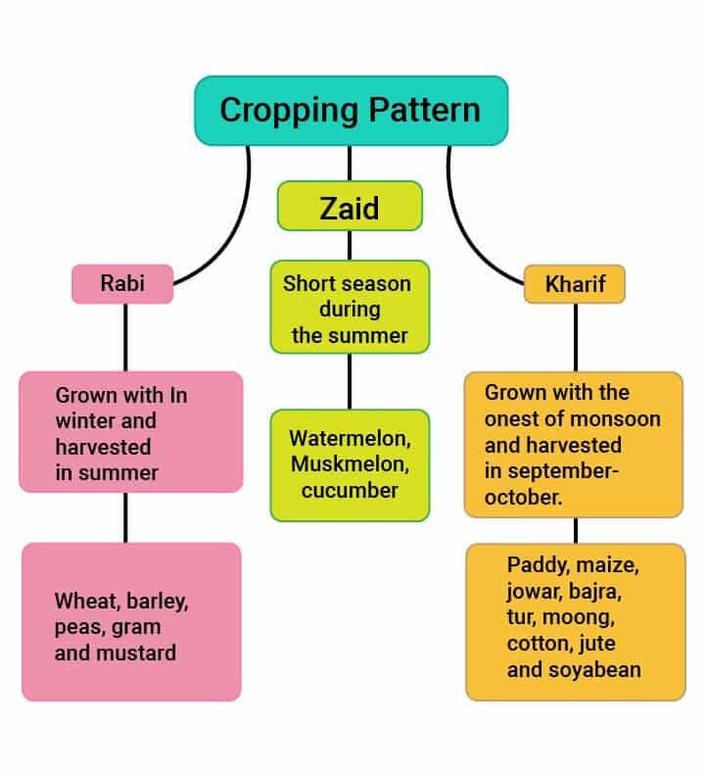
INTRODUCTION
Different types of Crops.
Farmers Problems.
Cropping Patterns.
Agricultural Factors for Crop
Cultivation
Solutions for Farmers Problems.

Slide 5
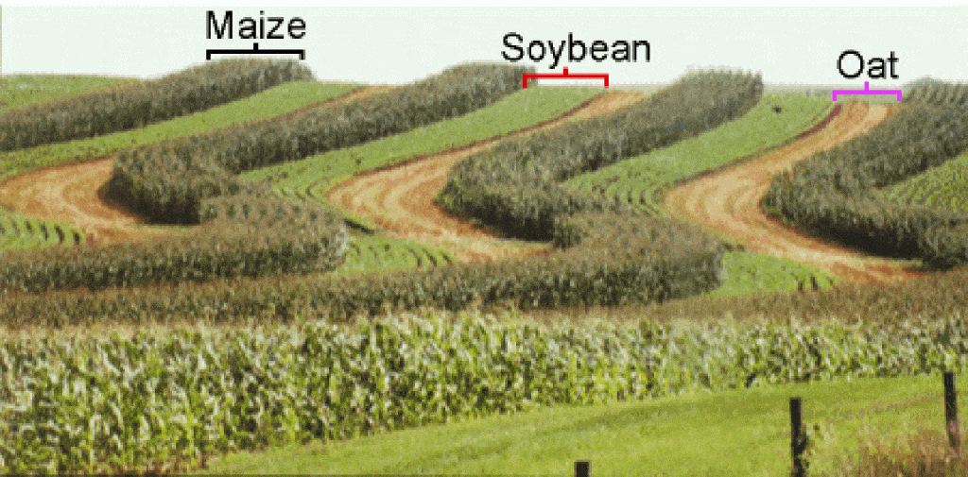
INTRODUCTION
Cropping Patterns.

Slide 6
LITERATURE SURVEY
IEEE PAPER TITLE 1: Prediction of Crop Cultivation
YEAR OF PUBLICATION: 2020
AUTHORS: Neha Rale, Raxitkumar Solanki, Doina Bein, James Andro-Vasko, Wolfgang Bein.
METHODOLOGY: linear regression with polynomial features, and support-vector regression using a Radial Basis Function (RBF) kernel.
LIMITATIONS:
Linear regression and support vector regression generates outputs graphically which is difficult to analyze.
Not suitable in real time.
Small Data-set used for prediction.
Cropping patterns not predicted.

Slide 7
LITERATURE SURVEY
IEEE PAPER TITLE 2: Crop Yield Prediction and Efficient use of Fertilizers.
YEAR OF PUBLICATION: 2021
AUTHORS: S.Bhanumathi, M.Vineeth and N.Rohit.
METHODOLOGY: Random Forest and Back propagation algorithm used for implementation.
LIMITATIONS:
Less parameters used for crop and yield prediction
Based on fertilizers , system predicts crop yield , but not considering all agriculture parameters.
Cropping patterns not predicted.

Slide 8
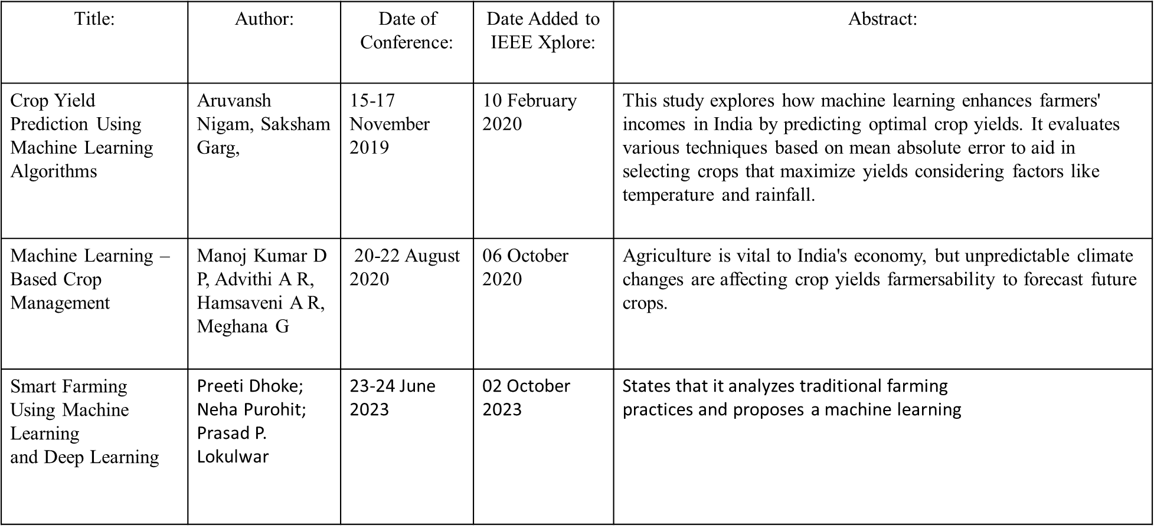
LITERATURE SURVEY

Slide 9
LITERATURE SURVEY SUMMARY
In real time it is very important to know the cropping patterns for the farmers to earn good profits. Current system is manual system where based on the previous crop cultivations and experience farmers will decide the crop types to grow. Sometimes farmers may get good crop yield and profits but sometimes crop selection may lead to poor crop yield and loss to the farmers. Many research papers worked on this topic where they mainly concentrated on crop prediction using machine learning but not cropping patterns prediction which proposed system does. All existing works are just models but not real time implementation. We require a system that can automatically predicts the cropping patters and helps farmers to know the right crop types to grow to get better yield and profits.

Slide 10
LITERATURE SURVEY SUMMARY
Drawbacks of Existing System
Only crop prediction not cropping patterns prediction
Manual process
Previous results and experience considered
Leads to wrong estimations.
Loss to farmers
Less crop yield
No real time implementations done

Slide 11
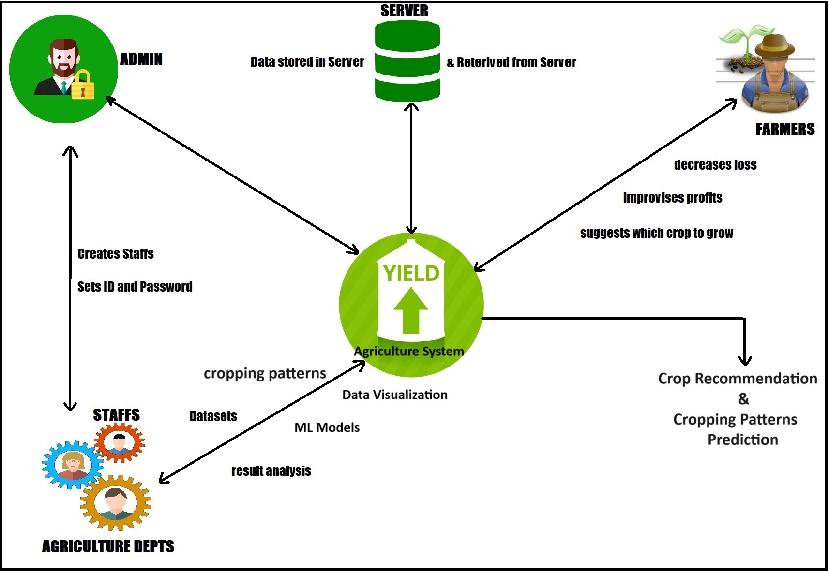
OVERALL ARCHITECTURE

Slide 12
Users
User Requirements
Administrator
Administrator is a person who maintains the entire application. System contains only one administrator.
Location In-charger/Staff
Staff is an actor who receives the services from the application. Staff is a person who is incharge of a particular location. Staffs created by the administrator.
Visitors/Farmers
Visitors are the users who can access the basic agriculture information.

Slide 13
Proposed System
The main aim of proposed system is to build model with real time application for farmers and agricultural department
The major objective is to find cropping patterns using ml algorithms
We can collect the dataset either from online or offline
Visual studio tool used to design impressive designs.
We have GUI based software for sections like front end farmers input details,GUI for Login,GUI for show train dataset ,model,algorithm,patterns,data visualization ect..

Slide 14
System Requirements
Hardware Requirements
RAM – 4GB
HardDisk – 500 GB \ SSD 256
Processor – oct core,i3,i5,i7
Speed – 2g hz
Software Requirements
OS – Windows
Browser– Google Chrome
FireFox
Front End – Visual Studio
Backend – SQL Server
Language – C#,C,C++

Slide 15
PROPOSED METHODOLOGY
Unsupervised Machine Learning
Association (or relation) is probably the better known and most familiar and straightforward data science technique. Here, we make a simple correlation between two or more items, often of the same type to identify patterns.
For example, Market-basket analysis, where we track people's buying habits, we might identify that a customer always buys cream when they buy strawberries, and therefore suggest that the next time that they buy strawberries they might also want to buy cream.
In our project Association Learning Algorithm “Apriori Algorithm / Eclat Algorithm” is used to predict using the agriculture data-set.

Slide 16
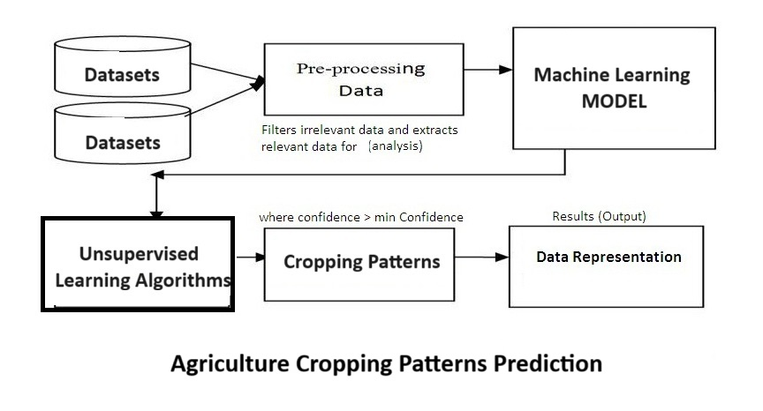
PROPOSED METHODOLOGY

Slide 17
PROPOSED METHODOLOGY
Step 1: Raw data and Weather Statistics
Step 2: Extract and Segment Data (Data Preprocessing)
Step 3: Train Data
Step 4: Unsupervised Learning Algorithms
Step 5: Cropping Patterns
Step 6: Location and Year Based
Step 7: Visual Representation

Slide 18
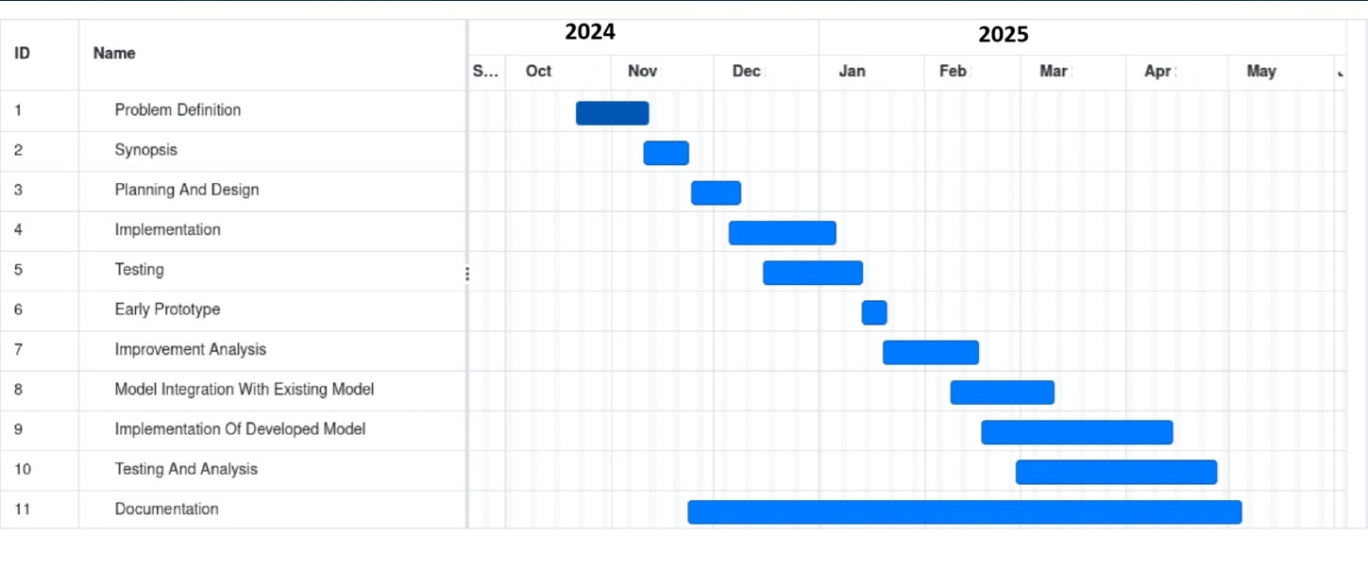
PROPOSED PLAN OF ACTION

Slide 19
EXPECTED OUTCOME
Agriculture Cropping Patterns Prediction System:
It is crucial for the farmers to know what all different types of crops can be cultivated in his/her land so as to get good crop quality and yield. As current system is the manual system which needs more time, experience and proper judgements which may lead to less crop yield and loss to farmers. There are important relationship between different types of crops so as to get better crop yields. As we do not have the proper system to find the cropping patters, we require a automation for cropping patterns prediction to help farmers to grow better crops types for better yield and profits. System helps farmers to grow right crop on right time. System will suggests the farmers the priority based crops to grow to get proper yield and profits.

Slide 20
REFERENCES
[1] Subhash K., “ SWOT analysis of the Pune district - 12th five year plan (2012-13 to 2016-2017)” , Central Assistance Scheme - Rashtriya Krishi Vikas Yojna (RKVY), 1-171, 2018 report [online] http://krishi.maharashtra. gov.in/Site/Upload/Pdf/pune_cdap.pdf (Accessed 1 May 2019)
[2] Surajit Bera et. al.,“Land Suitability Analysis for Agricultural Crop using Remote Sensing and GIS - A Case Study of Purulia District” . IJSRD - International Journal for Scientific Research & Development, vol. 5(06), pp.999-1024, 2017
[3] Puntsag G ,” Land suitability analysis for urban and agricultural land using GIS: Case study in Hvita to Hvita, Iceland” . United Nations University Land Restoration Training Programme, 2014 http://www.unulrt.is/static/fellows/document/Puntsag2014.pdf
[4] Prakash T.N., “ Land Suitability Analysis for Agricultural Crops: A Fuzzy Multicriteria Decision Making Approach” , 2019 [Thesis] (Last accessed 15 September 2019)
[5] R. N. Bhimanpallewar, M. R. Narasinagrao, “ A Survey of Automated Advisory Systems in,” Int. J. Adv. Res. Electr.Electron. Instrum. Eng., vol. 4, no. 2, pp. 1022-1030, 2015

Slide 21
THANK YOU

